Slide 1


Implementation, Dissemination, & Evaluation of Cognitive Behaviour Therapy with Mindfulness (CBTm) Classes for Mood and Anxiety Disorders
Jitender Sareen MD
Tanya Sala MD
Tara Brousseau Snider

Slide 2
Faculty Disclosure
Sareen - UPTODATE
No industry..

Slide 3
Learning Objectives
Review the evidence base for CBT for mood and anxiety disorders
Describe the process of implementation and Evaluation of CBTm classes
Articulate the lessons learned and future directions

Slide 4
Speakers
Jitender Sareen
Past, Present, future direction
Tanya Sala
Content Development
Tara Brousseau-Snider
CBTm implementation in Mood Disorders Association of Manitoba

Slide 5
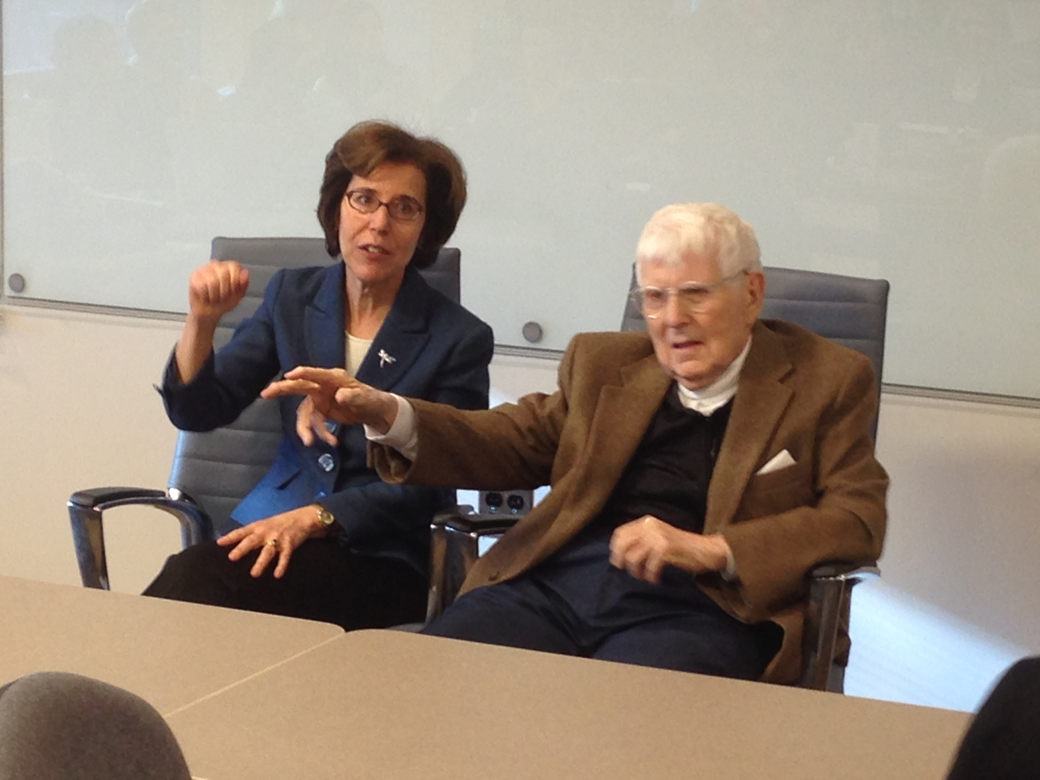
Acknowledgements
Patients and families
CBTm Team
Partners
A. Beck MD, J. Beck PhD
Gordon Asmundson PhD
Corey Newman PhD

Slide 6
Vision
To increase access to
Cognitive Behavior Therapy

Slide 7
Relevant Literature Update

Slide 8
Which country has implemented the Improving Access to Psychological Therapies program?
United States
Russia
India
England
China

Slide 9
Which country has implemented the Improving Access to Psychological Therapies program?
United States
Russia
India
England
China

Slide 10
Improving Access to Psychological Therapies - UK
957,000 annually are assessed by IAPT
537,000 people annually receive 2 or more sessions of therapy
Stepped care model
Anxiety Disorders- CBT
Depression – CBT, interpersonal, or couples

Slide 11
Outcomes – Improving Access to Psychological Therapy
Patient Health Questionnaire-9
Generalized Anxiety Disorder-7

Slide 12

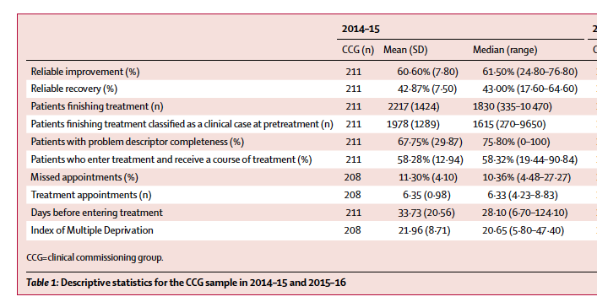
Clark et. Lancet 2018
2014-2016
Clark Lancet 2018
Clinical commissioning Group (CCG)

Slide 13
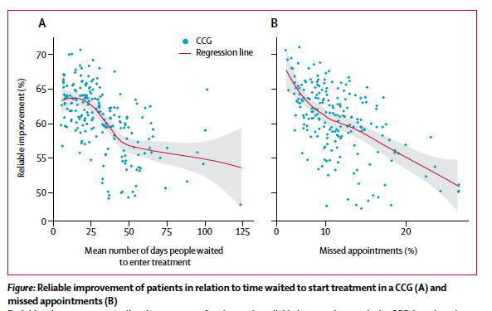
Clark Lancet 2018

Slide 14
Conclusions from UK study
Public funding to improve access to psychological treatment can improve outcomes
Longer delays in access to treatment is associated with lower likelihood of recovery
Clark Lancet 2018

Slide 15
Computer Assisted CBT is equally effective as Face to Face CBT
True
False

Slide 16
Computer Assisted CBT is equally effective as Face to Face CBT
True
False

Slide 17
Therapist-supported Internet cognitive behavioural therapy for anxiety disorders in adults
“The evidence suggests that therapist-supported ICBT may not be significantly different from face-to-face CBT in reducing anxiety.”
Cochrane Systematic Review Olthuis et al. 2016

Slide 18
Improving the Efficiency of Psychotherapy for Depression: Computer-Assisted Versus Standard CBT.
154 depressed patients randomized to:
Standard CBT (16-20 sessions)
Computer assisted CBT using “Good Days Ahead”
1/3 therapist time compared to standard CBT
Thase et al. Am J Psychiatry 2017

Slide 19
Improving the Efficiency of Psychotherapy for Depression: Computer-Assisted Versus Standard CBT.
The study findings indicate that a method of CCBT that blends Internet-delivered skill-building modules with about 5 hours of therapeutic contact was noninferior to a conventional course of CBT that provided over 8 additional hours of therapist contact.
Thase et al. Am J Psychiatry 2017

Slide 20
Is there evidence to support web-based CBT in reducing suicidal ideation?
Yes
No

Slide 21
Is there evidence to support web-based CBT in reducing suicidal ideation?
Yes
No

Slide 22
Web-Based Cognitive Behavioral Therapy Intervention for the Prevention of Suicidal Ideation in Medical Interns: A Randomized Clinical Trial.
Interns were randomly assigned to 2 study groups (wCBT and attention-control group [ACG]), and completed study activities lasting 30 minutes each week for 4 weeks prior to starting internship year.
Participants assigned to wCBT completed online CBT modules and those assigned to ACG received emails with general information about depression, suicidal thinking, and local mental health professionals.
Guille et al. JAMA Psychiatry 2015

Slide 23
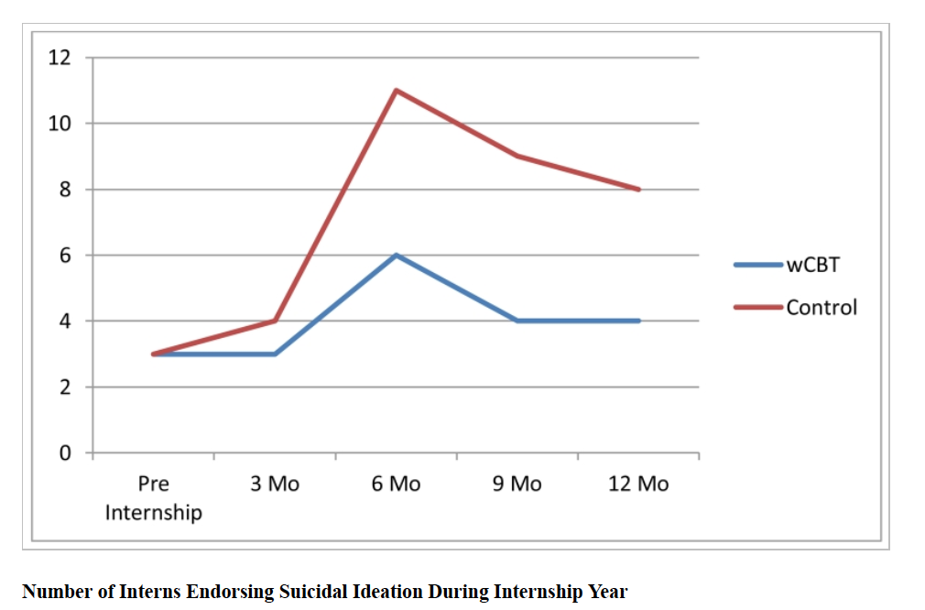
Web-Based Cognitive Behavioral Therapy Intervention for the Prevention of Suicidal Ideation in Medical Interns: A Randomized Clinical Trial. PHQ-9 – Suicide ideation
Guille et al. JAMA Psychiatry 2015

Slide 24
How effective are large psychoeducation groups in reducing symptoms?
Not effective
Minimally effective
Moderately effective
Curative

Slide 25
How effective are large psychoeducation groups in reducing symptoms?
Not effective
Minimally effective
Moderately effective*
Curative
Limited RCT data

Slide 26
A multi-service practice research network study of large group psychoeducational cognitive behavioural therapy.
4451 participants
Pre-post effect size d =0.70
Large group psychoeducational CBT is clinically effective, organizationally efficient, and consistent with a stepped care approach to service design.
Delgadillo et al. Behavior Research Therapy 2016

Slide 27
Genesis of CBTm Classes

Slide 28
Timeline
2013
Waiting time for CBT >1 year
Partnerships with CODI program and Clinical Health Psychology (Quickstart)
Developed the Class-based Model
January 2014
2-session CBT classes for Anxiety disorders
January 2015
4-session CBT classes for Mood and Anxiety Disorders

Slide 29
CBTm Classes
Learn the basic principles of CBT for depressive and anxiety symptoms
Learn about good quality self-help CBT resources
Get a head start on CBT as part of their recovery

Slide 30
CBTm Classes
Minimal Exclusion criteria
Cognitive impairment, high suicide risk, and psychotic symptoms
Four 90 min sessions
Up to 50 people per class
One family member or support person per client invited.

Slide 31
Why classes?
CBT is first line for mood and anxiety disorders and is not easily accessible in the public funded system
Unmet self-perceived need for psychotherapy is greater than unmet need for medications

Slide 32
Why Classes are innovative in delivering therapy?
Everyone has been in a class, not everyone has been/wants to be in therapy
Psychoeducation format provides a less intensive environment
Reduce waiting times

Slide 33
Why Classes?
Improves efficiency
After attending the classes people are more socialized to the expectations for therapy
Self-selection into more intensive therapy

Slide 34
CBT at HSC – Changes
A. Old service delivery model
12-18 months
Group Therapy
Referral
Screening Visit
B. New service delivery model
3-6 months
Intake
Visit
Education Classes
Group Therapy
Referral
Self-help strategies encouraged
Patients attend a minimum of 4 education classes in order to be eligible for group therapy.
Notes:
For the past several years, this has been the delivery model for CBT at HSC. Patients would be referred to PsycHealth and then wait over a year on average to access services. Exclusion criteria…
Last year, a new process was implemented, based on a Stepped Care Model.
Patients are now screened within 2 weeks of referral, and invited to attend large group CBT education classes while they are on the waiting list for group therapy.
The only exclusion criteria are active psychosis, high suicide risk, and severe cognitive impairment.
These education classes were 90-minutes in length and offered in pairs occurring one week apart. Patients are required to attend 2 such classes in order to be eligible for group therapy.
Classes such as these have been studied only minimally in previous CBT research, and never before in the context of Stepped Care. This provided a unique opportunity to conduct research.

Slide 35
CBT Groups at HSC Mental Health Program
After intake and CBTm sessions
People can access 10 session group therapy for
Depression
Mixed Anxiety
Obsessive Compulsive Disorder
CBT for psychosis (separate pathway)

Slide 36
Manitoba Patient Access Network Partners 2016-17 -$100,000
Anxiety Disorders Association of Manitoba
Mood Disorders Association of Manitoba
Crisis Response Centre
St. Boniface Hospital Mental Health Program
Clinical Health Psychology Program
Victoria Hospital Mental Health Program
Child and Adolescent Mental Health Program
Interlake-Eastern Regional Health Authority
Grace Hospital Psychiatric Ambulatory Program
Veterans Affairs Operational Stress Injuries clinic

Slide 37
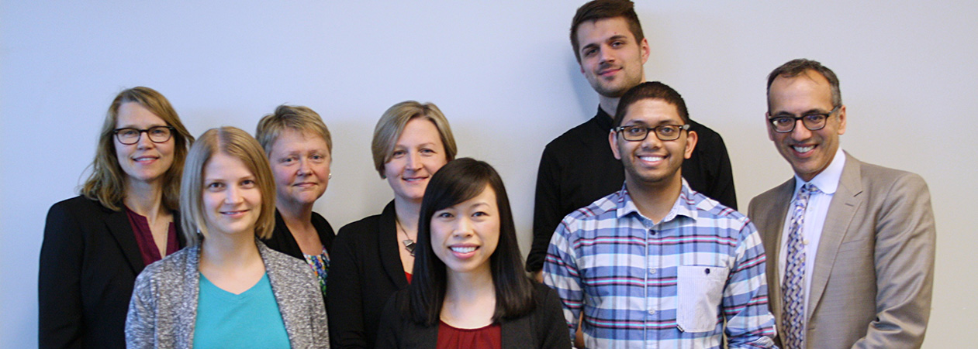
Manitoba Patient Access Network

Slide 38
Key Goals of Manitoba Patient Access Network
Improve quality of class content using a Quality Improvement Framework
Develop a Facilitator manual
Hold Facilitator Training workshops
Develop an online website

Slide 39
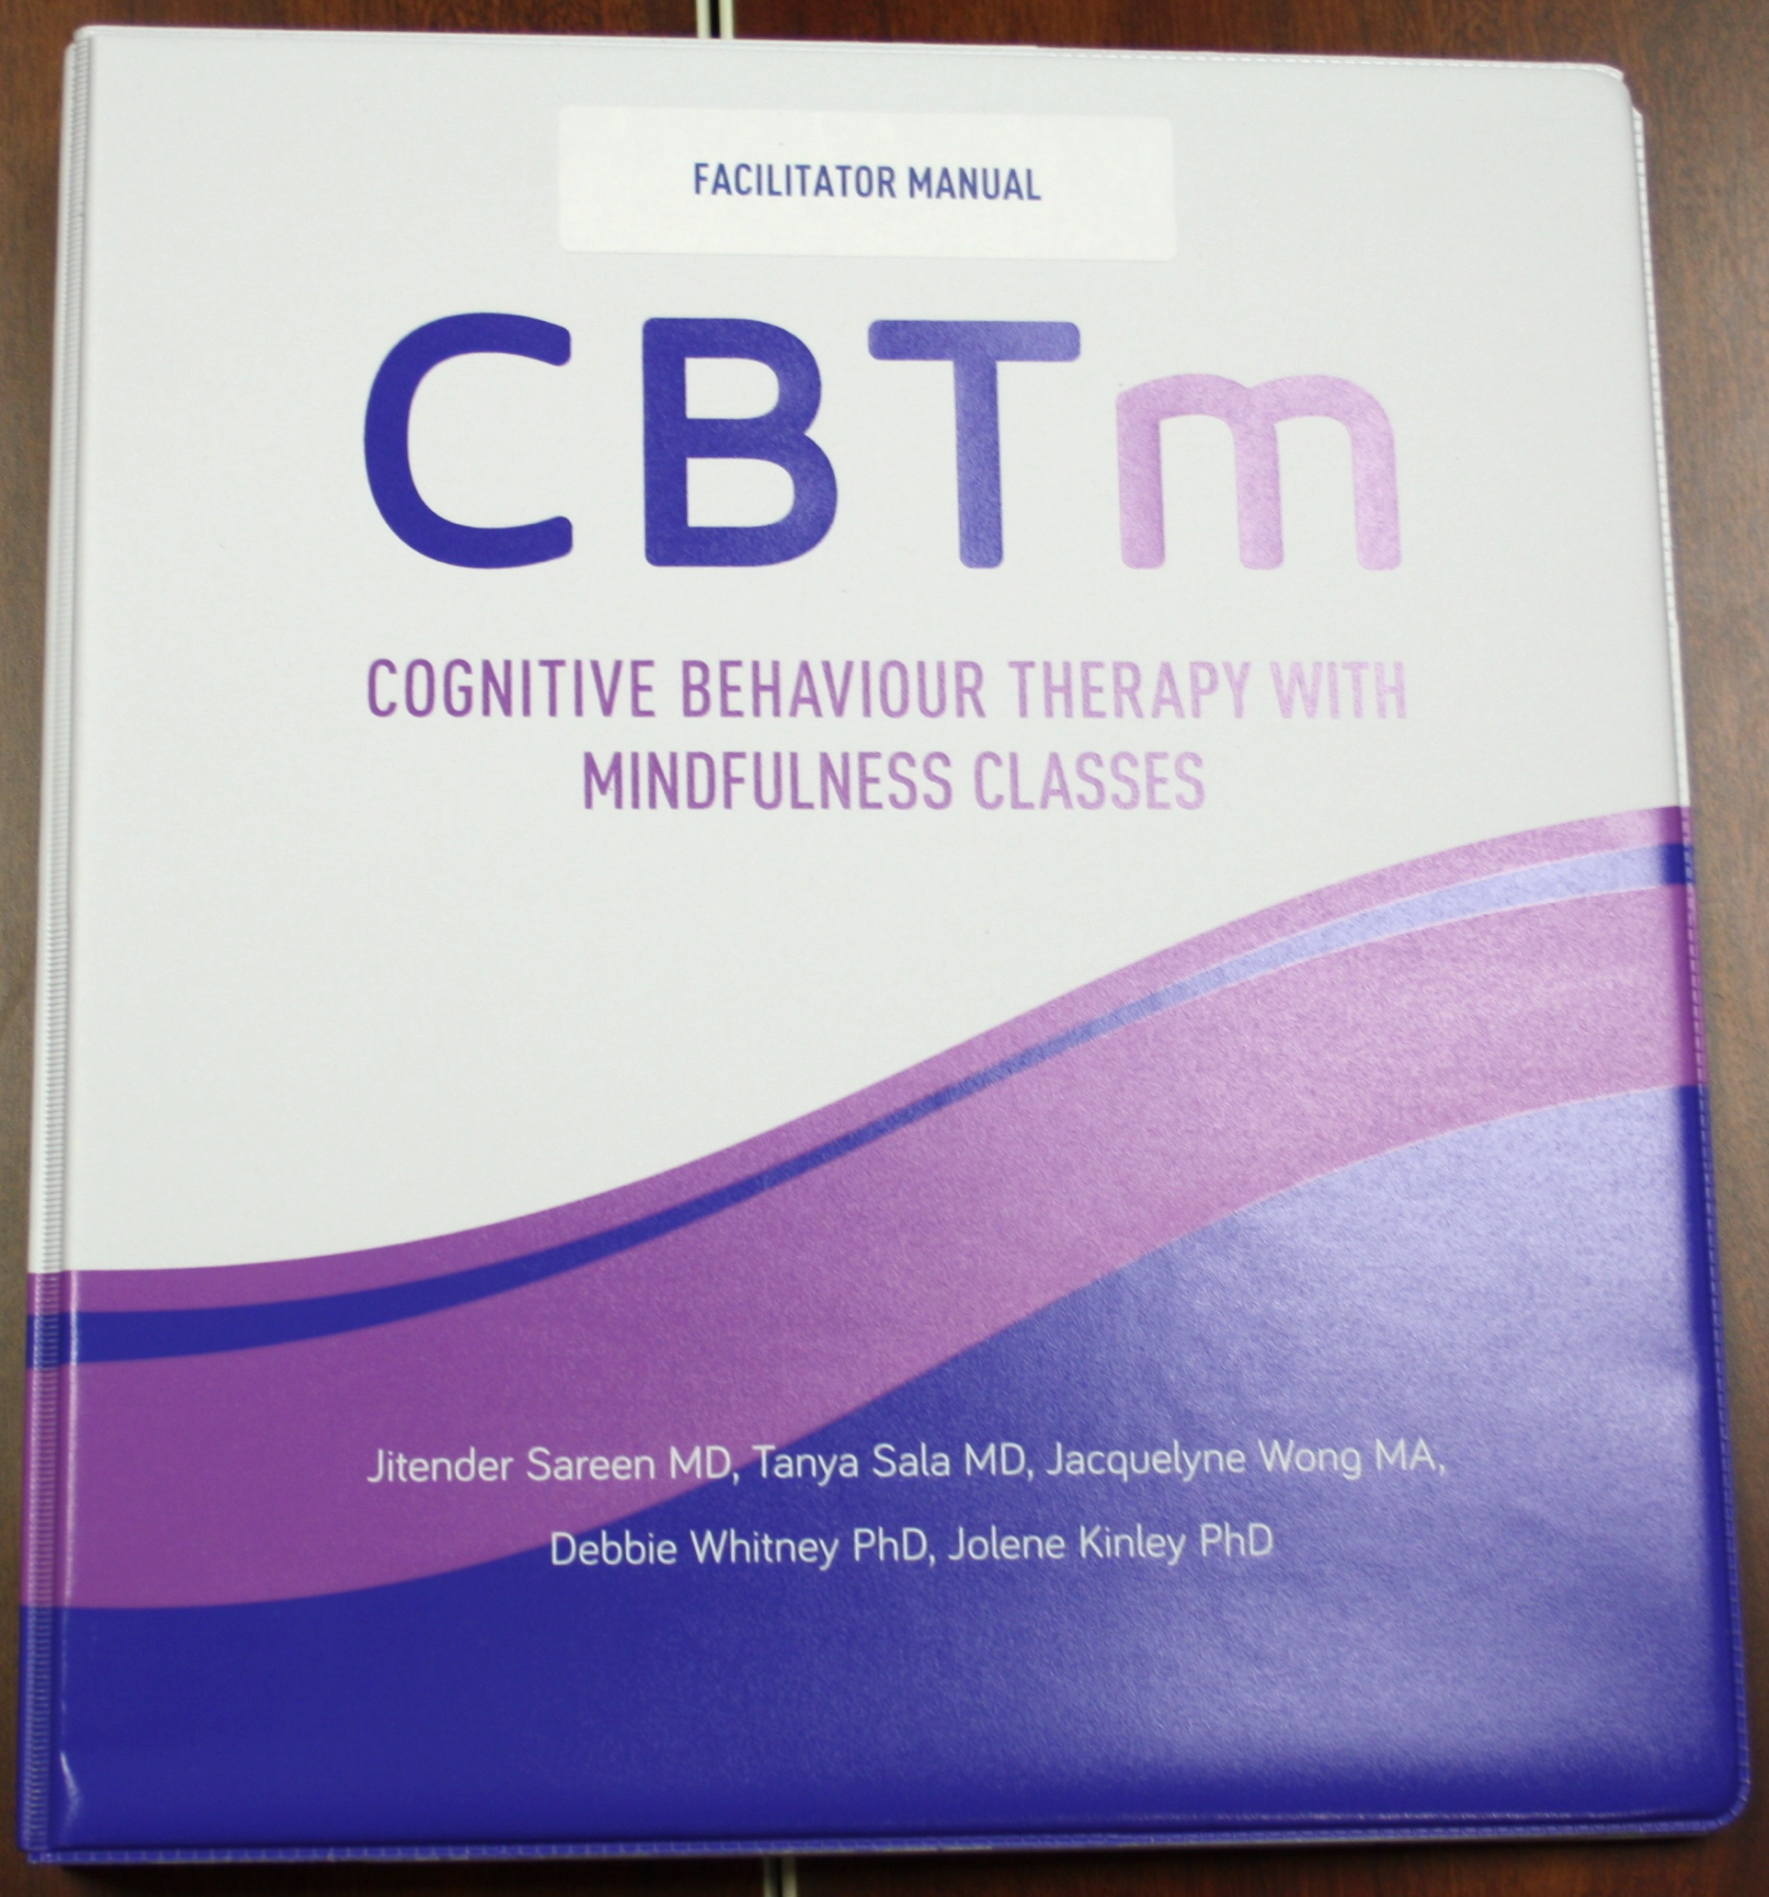
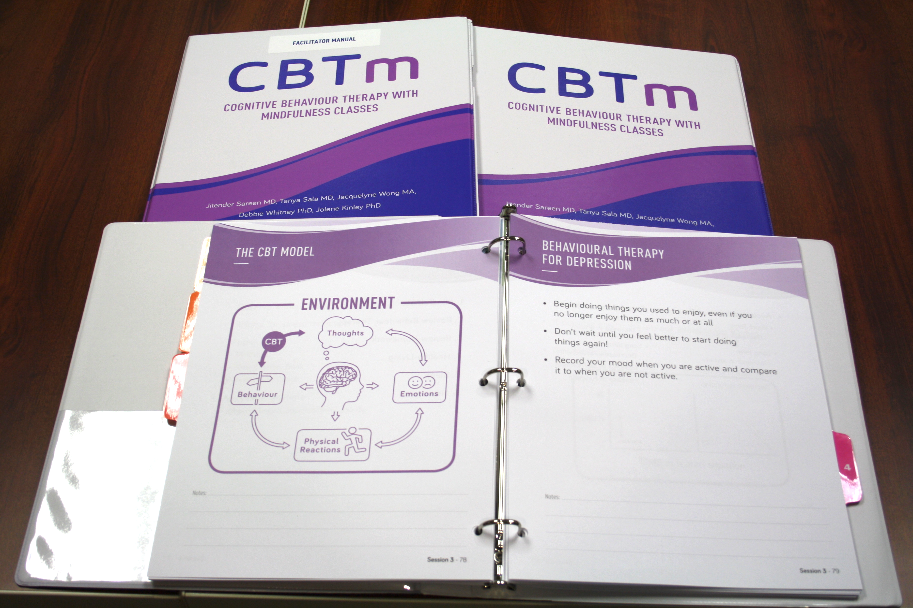
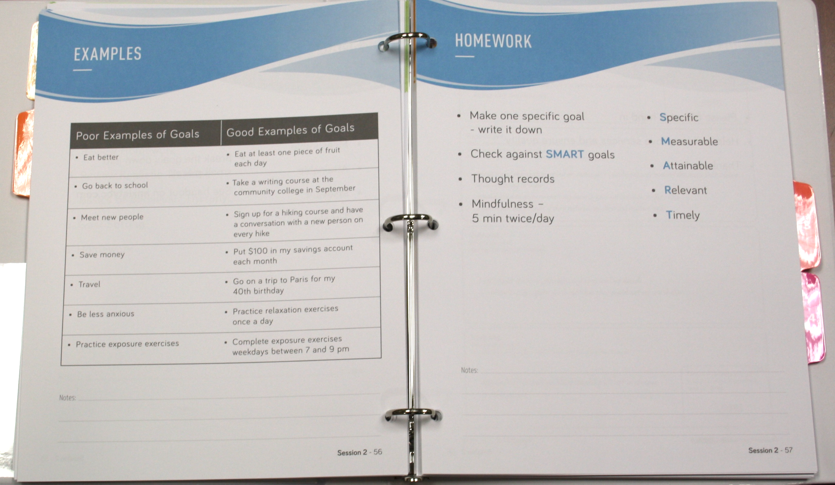
CBTm Client and Facilitator Binders

Slide 40
www.CBTm.ca
June 2017
Free online content for clients
Free facilitator manual for facilitators
After registration

Slide 41
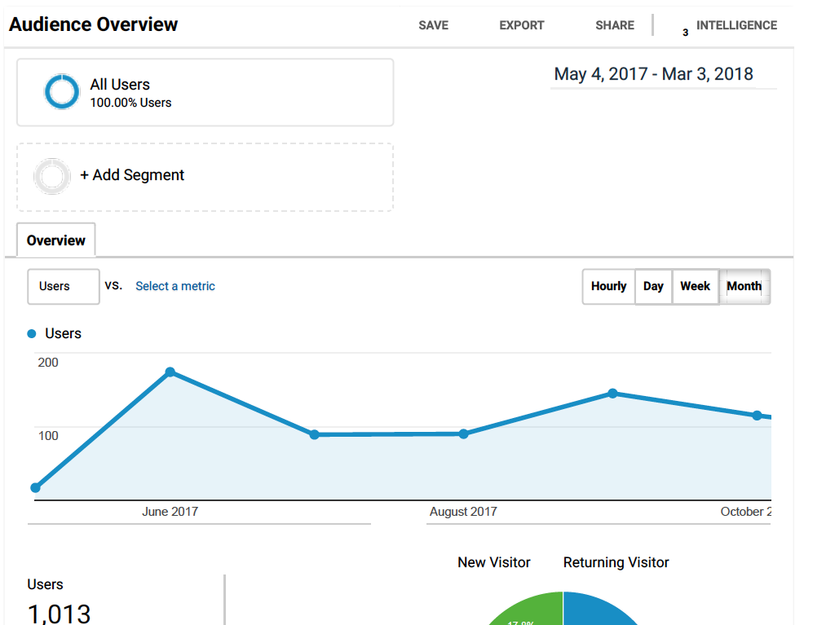
>1000 users since inception of the Website

Slide 42
Multiple Facilitator Training workshops
Physicians
Nurses
Occupational Therapists
Social workers
Pharmacists
Peer-support – MDAM, ADAM
Addictions Foundation of Manitoba

Slide 43
Today’s Workshop 1-5pm – 38 New Facilitators
Mood Disorders Association of Manitoba
Addictions Foundation of Manitoba
WRHA Mental Health Program
WRHA Primary Care
Private practice

Slide 44
Feasibility of Large Group Cognitive Behavioural Therapy Education Classes for Anxiety Disorders
Joshua E. Palay, Jacquelyne Y. Wong, Jason R. Randall, Tanya Sala, James M. Bolton, Patricia Furer, Shay-Lee Bolton, Debbie L. Whitney, Sagar Parikh, & Jitender Sareen. The European Journal of Person-Centered Health Care, (In Press).
Persistence, Persistence…

Slide 45
An Evaluation of Large Group Cognitive Behaviour Therapy with Mindfulness (CBTm) Classes for Mood and Anxiety Disorders
Vishal K. Thakur, Jacquelyne Y. Wong, Jason R. Randall, James M. Bolton, Joshua Palay, Tanya Sala, Jolene Kinley Natalie Mota, Sagar Parikh & Jitender Sareen
BSc Med student project.

Slide 46
CBTm Classes
Dr. Debbie Whitney led a grant application to the Bell Let’s Talk – True Patriot Love Fund
Adapt classes to be delivered by mental health clinician, peer support counsellor, or peer support volunteer.

Slide 47


2016 Bell/True Patriot Love Fund supports CBTm classes for Resilience
Are you a mental health clinician, peer support counsellor or volunteer working with Canadian Forces members, veterans and/or their families?
Do you want training to deliver CBTm classes to promote resilience?
Contact: Debbie Whitney, Winnipeg OSI Clinic
dwhitney@deerlodge.mb.ca or 204-831-3429
Notes:
Funding supports training 15 facilitators (who work with active and retired military and their families) and equiping them to deliver the 4 CBTm classes to 20 participants. There will be a one day training in Winnipeg in February 2017. The training team will provide mentorship for the facilitators as they roll out the classes at their home location. Priority training for those in Manitoba, Saskatchewan and northwestern Ontario. Spots opened to those from other locations if the training session is not full.

Slide 48
Adaptation of CBTm classes for medical students
Tanya Sala MD et al.
Two objectives:
Build resilience
Teach CBT

Slide 49
Mota, Bolton, Holmqvist, Sareen (2017)
Manitoba Medical Services Foundation and Winnipeg Foundation Operating Grant
“The effectiveness of psychotherapy classes in reducing suicidal ideation in a crisis population”
Examine the effectiveness of CBTm and DBT skills psychotherapy classes on reducing suicidal thinking.

Slide 50
Kinley, Sareen, Sala, Wong, Whitney, McConnell (2018)
University of Manitoba Grant
“CBTm classes in a rural community mental health program”
Chart review 2015-2017
Evaluate CBTm classes in a rural area
Evaluate the impact of providing classes using telehealth versus in-person

Slide 51

Workers Compensation Board Grant

Slide 52
Sareen, Mota, Sala, Wong et al (2017 - 2019)
WCB of MB, RWIP Grant
“Online and classroom delivered mindfulness-based cognitive behaviour therapy course for building workplace resilience: Pilot RCT”
Adapt and provide CBTm Classes for public safety personnel (firefighters, police officers, paramedics) and nurses.

Slide 53
Jacquelyne Wong PhD Student
PhD thesis
Evaluation of a CBT Stepped-Care Intervention for Anxiety and Mood Disorders
RCT of CBTm classes

Slide 54
Future Developments
Adaptation for Swampy Cree First Nations Communities
Translation to French

Slide 55
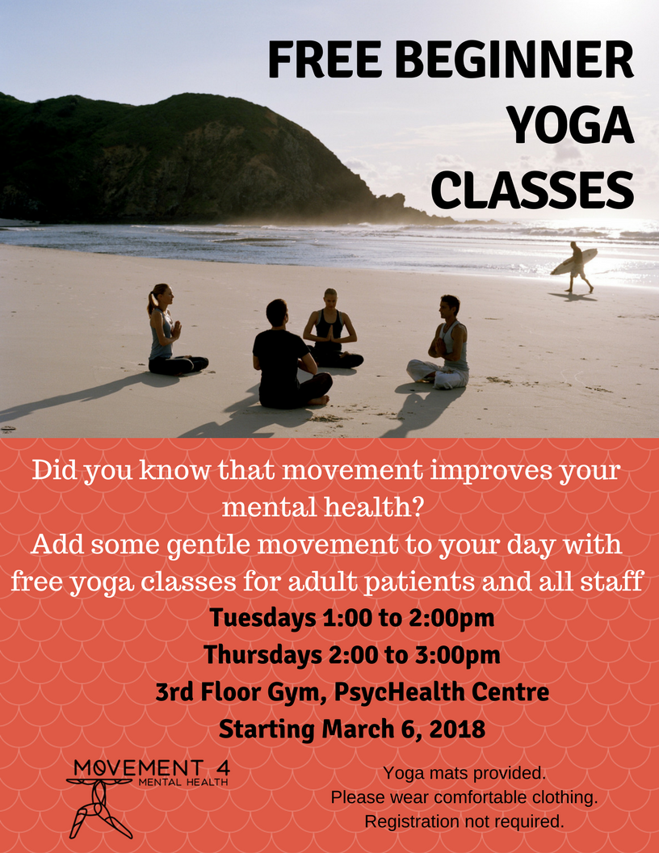

Movement 4 Mental Health Classes at HSC

Slide 56
Summary
CBTm class improve access, reduce waiting times
Improve Efficiency
Builds capacity
Limitations - uncontrolled evaluation
Quality improvement, systematic evaluation

Slide 58
Beck Institute –
Visitor Training – worth the trip to Philadelphia
CBT for personality disorder
CBT for Addictions
CBT for suicidal behavior
CBT for Psychosis –(HSC – ongoing)
https://www.youtube.com/watch?v=mAHweFpGZ9I

Slide 59
Future Directions
Extension of Community Health Outcomes - (ECHO)
https://www.echoontario.ca
Project ECHO links expert inter-professional teams at an academic hub with primary care providers in local communities. Primary care providers, the spokes in our model, become part of a learning and support community, where they receive mentoring and feedback from the team of experts. Working together, community providers get the help and the support they need to provide care to their patients as close to home as possible.

Slide 60

COGNITIVE BEHAVIOUR THERAPY WITH MINDFULNESS CLASSES
Session #1
Jitender Sareen MD, Tanya Sala MD, Jacquelyne Wong MA,
Debbie Whitney PhD, Jolene Kinley PhD
Notes:
Welcome to everyone!
Introduce facilitators.

Slide 61

GROUND RULES
Please respect everyone’s confidentiality
Please do not share with the class personal stories of trauma or suicidal or violent thoughts
If you are distressed, please talk to staff members individually
Notes:
This is a class, so we encourage you to ask questions and share information about what’s been helpful for you so that everyone in the class can learn from each other. However, because this is a large group, it’s not the right setting to discuss personal trauma or suicidal or violent thoughts, which may be distressing to others in the group. If you’re in crisis and need to talk about any of these things, please approach one of the facilitators during a break or after class.

Slide 62
OUTLINE FOR TODAY
Why these classes?
Mindfulness
What is CBT?
Realistic thinking
Homework
Notes:
Discuss the structure of the class:
Each week there will be an outline, mindfulness exercise, new material, skills practice.
Ask the group: “Are there any questions?”

Slide 63
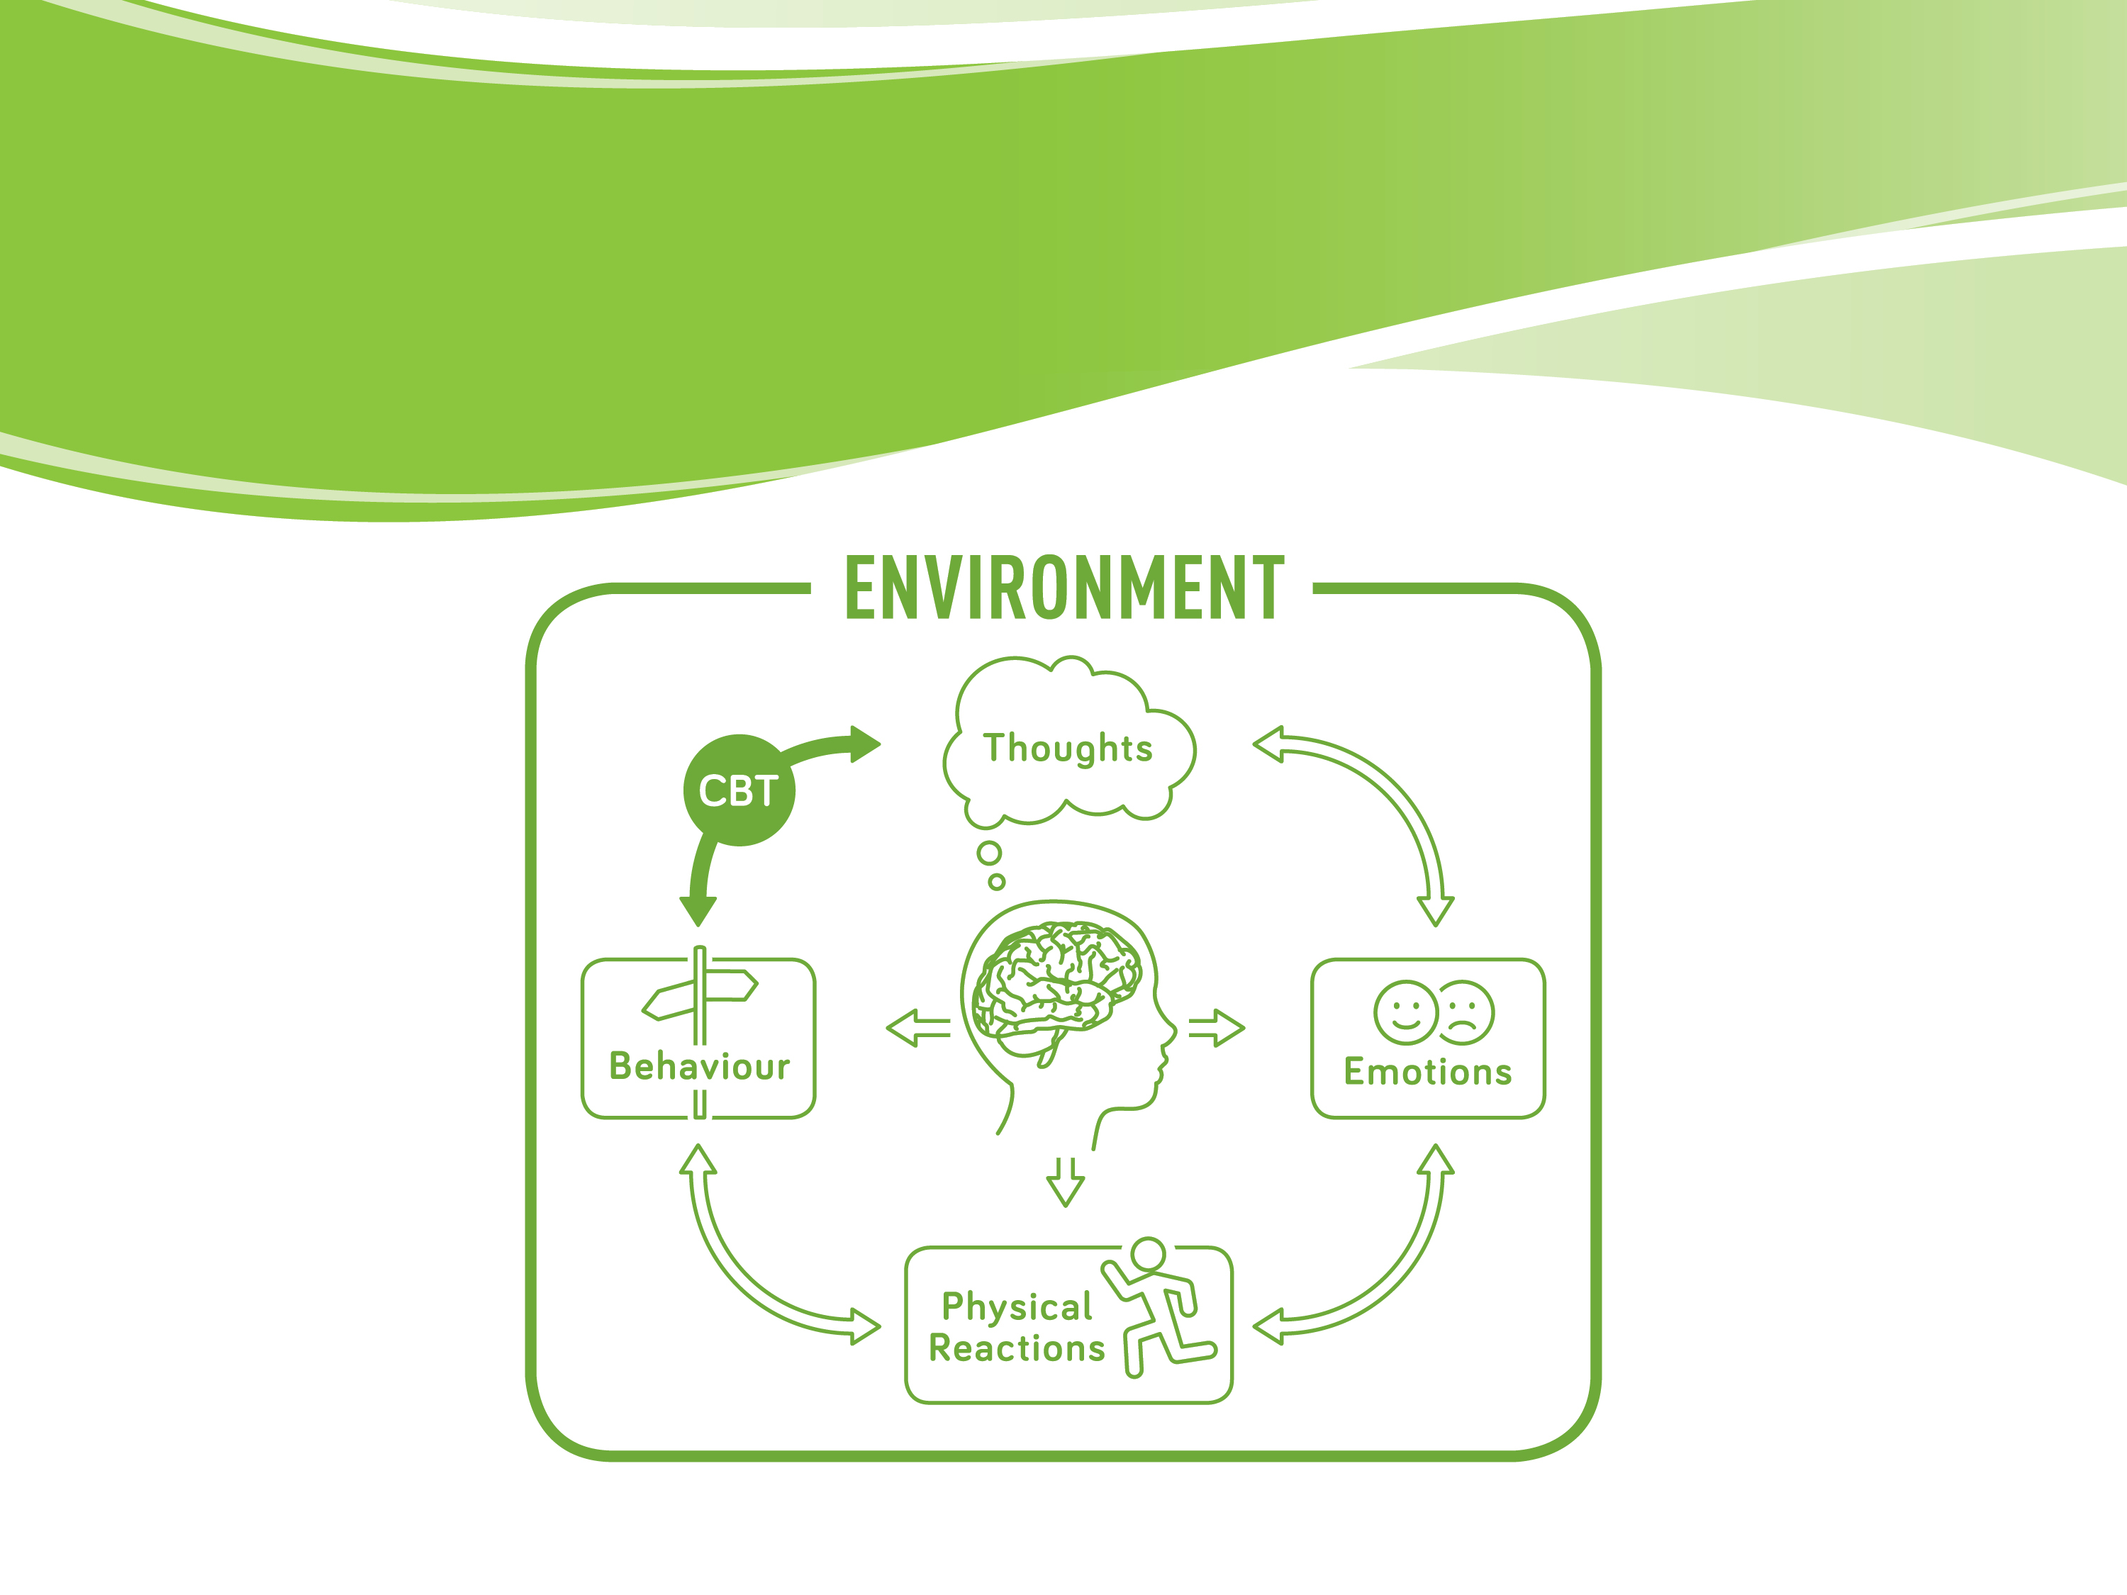
THE CBT MODEL
Notes:
Explain the diagram to the group.
THOUGHTS
• In any situation, you have certain thoughts about the situation.• For example, sitting in class right now, you might be having certain thoughts. If you’re having thoughts that this lesson makes sense, you might be feeling good about the classes and will come back. The way you think affects how you feel.
• If you are feeling upset or anxious in the situation, this will affect how you view the situation.
• For example, if you had a panic attack in Walmart, you are more likely to have anxiety in that same situation or in a crowd. You might not be thinking anything negative, but because you were anxious in that situation before (Walmart), you are more likely to experience the anxiety again (in Walmart or other similar stores). You might start worrying about going to Walmart because you expect to feel anxious there.
FEELINGS
• There are two types of feelings: emotional and physical (chest pain, shortness of breath, stomach ache).
• These feelings influence our thoughts and behaviours (actions).
• Sometimes you feel anxious and don’t know why. You can try and understand where it’s coming from, but you may not figure it out.
• The goal in CBT is to reduce the anxiety to improve functioning, not to get rid of anxiety.
Example of concept: “I feel stupid”
Ask the Group: Is this a feeling or a thought?
(Answer: It’s a thought.)
Feelings: one word – descriptive, not judgment
Thoughts: evaluations, opinions
BEHAVIOURS
The most common behaviours associated with anxiety and/or depression are avoidance and withdrawal. Avoidance is the main source of disability in anxiety disorders, which can be thought of as “The disorders of missed opportunities”. Avoidance and withdrawal often lead to a sense of relief in the short term, but a sense of sadness and increased anxiety in the long term. We’ll talk more about that in Class 2.
Usually, people come for treatment because they want to change their negative feelings, but this is hard to do directly. We have more control over thought patterns and behaviour patterns. By changing unhelpful thinking and behaviours, CBT can help you shift the connections between negative thoughts, behaviours and feelings.

Slide 64
COGNITIVE
THEORY
When we are feeling anxious, sad, or angry, we are usually thinking negatively
These negative thoughts can make the negative feelings stronger
If we can recognize this negative thinking, and change the thinking, it can help reduce the negative feelings
Notes:
• The Cognitive Model applies to everyone, not just those with anxiety and depression.
• But, those with anxiety and depression tend to have more frequent and intense negative thinking – many situations, most of the time.
Key message:
• When you have a negative thought, it’s important to ask yourself whether the way you’re thinking about the situation is realistic and balanced.

Slide 65
COGNITIVE
MYTH
Myth
“Cognitive Therapy is to help people think positively”
Truth
“Cognitive Therapy is to help people think flexibly and balanced”
Notes:
The goal is balanced, realistic, flexible thinking – not just positive thinking.
See different perspectives, recognize that having a thought/feeling does not mean that it is true, be able to test and objectively evaluate thoughts.

Slide 66
COGNITIVE THEORY
OF DEPRESSION
Negative view of self
Negative view of others
Negative view of future
Notes:
This is how CBT views the unhelpful thinking patterns in depression.
Examples:
•Self: I’m worthless, unlovable
•Others: Other people are unfriendly, uncaring
•Future: Things will never get better for me, hopelessness

Slide 67
COGNITIVE THEORY
OF ANXIETY
Two key thinking traps:
Overestimate the risk in the situation
Underestimate capacity to cope in the situation
Notes:
There are two common traps in thinking that underly problematic anxiety:
1. Overestimating the risk in a situation. Example: How likely a plane is to crash, how likely you are to embarrass yourself when you speak in front of others.
2. Underestimating your ability to cope in the situation. Example: If this happened (whatever the risk is), I will become overwhelmed and fall apart/be unable to cope. Sometimes people worry if they have a panic attack it will go on forever unless they do something to stop it, which isn’t true.

Slide 68
THOUGHT RECORD
Testing Your Thoughts worksheet
Notes:
One of the core tools of CBT is the thought record (Testing Your Thoughts worksheet), which is an exercise in balanced thinking.
We will go through this as a group, and then use time here to practice doing a thought record.
In any situation, when you are very upset, there is often more than one negative thought in your head. The exercise is to review the situation and pick one thought. To start, it is a good idea to pick a thought that might be easier for you to tackle.
The next step is the cognitive therapy skill of asking yourself – “What makes me think this thought is true?”
This exercise helps you train your mind to see different perspectives of the same situation.
Use the example provided in handouts to go through with the class or come up with another example that most could relate to (Example: public speaking).

Slide 69
COMMON THINKING TRAPS
Overgeneralization
All or Nothing Thinking
Fortune Telling
Emotional Reasoning
Labelling
Should Statements
Mind Reading
Mental Filter
Catastrophic Thinking
Personalization
Notes:
See Thinking Traps sheet.
We all have thinking traps! Those with anxiety and depression tend to have them more frequently, which can trigger and maintain anxiety and depression.
Overgeneralizing: Thinking that a negative situation is part of a constant cycle of bad things that happen. People who overgeneralize often use words like “always” or “never.” Example: I wanted to go to the beach, but now it’s raining. This always happens to me! I never get to do fun things!
All or Nothing Thinking (also called Black and White Thinking): Seeing things as only right or wrong, good or bad, perfect or terrible. People who think in black and white terms see a small mistake as a total failure. Example: I wanted to eat healthier, but I just had a piece of cake. This plan is a total failure! I might as well eat the whole cake!
Fortune Telling: Predicting that something bad will happen, without any evidence. Example: I’ve been studying hard, but I know that I’m going to fail my test tomorrow.
Emotional Reasoning: Believing that bad feelings or emotions reflect the situation. Example: I feel anxious when I fly, so airplanes must not be safe.
Labelling: Saying only negative things about yourself or other people. Example: I made a mistake at work. I’m stupid! My boss told me that I made a mistake. My boss is a total jerk!
‘Should’ Statement: Telling yourself how you “should” or “must” act. “Should” statements about ourselves lead to guilt. “Should” statements about others lead to anger and resentment. Example: I should be able to handle this without getting upset and crying!
Mind Reading: Jumping to conclusions about what others are thinking, without any evidence. Example: My friend didn’t stop to say hello. She must not like me very much.
Mental Filter: Focusing only on the negative parts of a situation and ignoring anything good or positive. Example: I met a lot of great people at the party, but one guy didn’t talk to me. There must be something wrong with me.
Catastrophic Thinking: Exaggerating the importance of negative things, believing the worst-case scenario, or thinking something is unbearable or impossible when it isn’t that bad. Example: I stumbled over my words during this presentation at work, so I’ll probably lose my job, lose my house, and be living on the street.
Personalization: You see yourself as the cause of some negative external event for which, in fact, you were not primarily responsible. Example: My husband looks irritable today. I must have done something to upset him.

Slide 70
HOMEWORK
Review materials
Mindfulness 5 min twice a day
One thought record & identify thinking trap(s)
Spend 15 min on anxietybc.com or heretohelp.bc.ca
Notes:
Tell the group that homework is a main component of CBT, and a large part of the work occurs between sessions. But…it’s not like homework from our school years! In CBT, homework means what we suggest you do during the week to practice applying the skills you’re learning in class. You don’t need to hand it in, and no one will be marking it or evaluating it. The more effort and time you put into doing the homework, the more you’ll get out of these classes.
• Set homework for upcoming week:
• Spend 10 minutes reviewing materials
• Mindfulness meditation 5 minutes x twice/day
• One thought record + identify thinking trap(s)
• Anxietybc.com - if you were referred for panic d/o, go to panic d/o section, watch video, read information on this, etc.
• Ask the Group: “Any questions about the homework?”
• Instruct patients to fill-out quality improvement questionnaires.

Slide 71

COGNITIVE BEHAVIOUR THERAPY WITH MINDFULNESS CLASSES
Session #2
Jitender Sareen MD, Tanya Sala MD, Jacquelyne Wong MA,
Debbie Whitney PhD, Jolene Kinley PhD
Notes:
Welcome to everyone!
Introduce facilitators.

Slide 72

OUTLINE FOR TODAY
Mindfulness
Review Homework
Review Realistic Thinking
Basics of Behaviour Therapy
Goal Setting
Homework
Notes:
Discuss the structure of the class:
Each week there will be an outline, mindfulness exercise, new material, homework.
Ask the group: “Are there any questions?”

Slide 73
BEHAVIOURAL
EXPERIMENTS
When you have challenged your thoughts
Understand (rationally) that it is a thinking trap
Still have high levels of anxiety, sadness, or anger
Still a part of you believes the thought

Slide 74
BEHAVIOURAL
EXPERIMENTS
Can you test your thoughts?
Prediction
Experiment
Outcome
Learning
Beginnings of behavioural therapy

Slide 75
BEHAVIOURAL THEORY OF ANXIETY
Avoid fearful situation
Short Term
- Decrease in anxiety
Long term
- Increase in anxiety - Decrease in self-esteem - Decrease in function
Notes:
Fear/anxiety > avoidance > reduced fear or anxiety > rewarding > more likely to avoid in the future. Reinforces anxiety and prevents learning that a situation is not dangerous – can only truly learn (and trust) by experience
Example: driving in a car vs. flying – much greater fear of planes – less frequent exposure/contact

Slide 76
BEHAVIOURAL THEORY
OF ANXIETY
Avoid fearful situation
Short Term
- Decrease in anxiety
Long term
- Increase in anxiety - Decrease in self-esteem - Decrease in function
Face fearful situation
Short Term
- Increase in anxiety
Long term
- Decrease in anxiety - Increase in self-esteem - Increase in function
Notes:
For situations that are not objectively dangerous or low probability – and important for meeting your life goals.
Key discussion points:
• It’s important to know that anxiety is unpleasant but not dangerous. Anxiety/fear is a signal of danger but is not dangerous itself.
• Avoidance feels good in the short term! That’s why avoidance patterns are so hard to break. It’s perfectly natural to want to avoid something that triggers anxiety in you.
• However, in the long term avoidance leads to increased anxiety, decreased self-esteem, and decreased function.
• Facing the feared situation leads to anxiety in the short-term. That’s why it’s difficult to do on your own, and you need skills and support.
• However, in the long term facing your fears leads to decreased anxiety, increase in self-esteem and increase in function.
• When your anxiety gets triggered in a situation that is not actually dangerous (or very unlikely to be dangerous), the anxiety will go down on its own without you doing anything to change it.
• When you face a fear, you learn that it’s not as dangerous as you thought, and you also learn that you have a greater ability to cope than you thought!

Slide 77
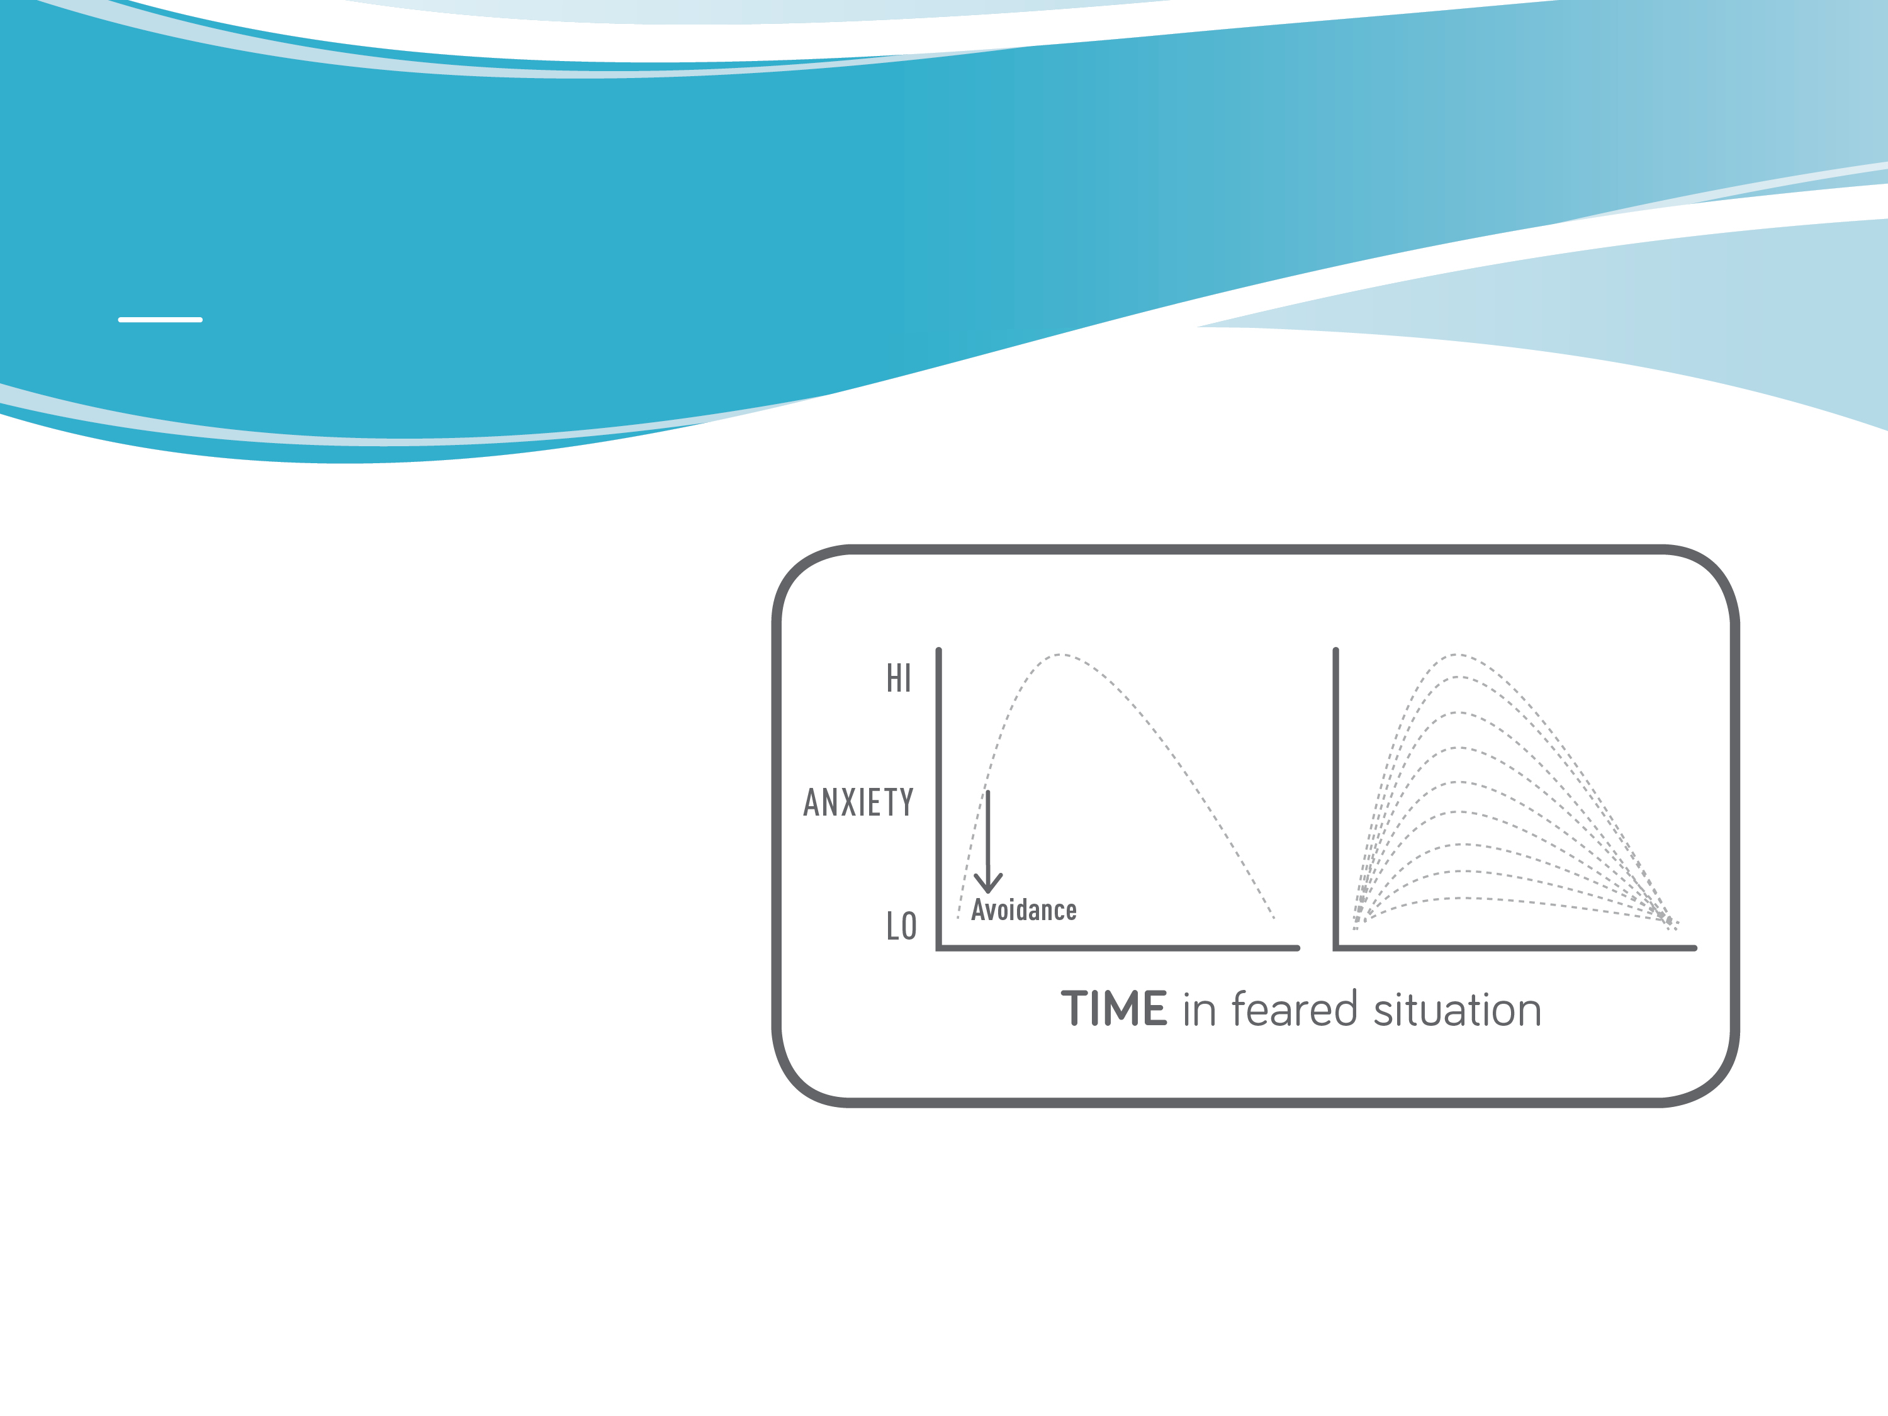
EXPOSURE
Facing your fears in a planned and repeated manner to fears.
Starting with fears that are a 3-4 out of 10 for an anxiety rating
Delay the avoidance
If possible stay in the anxious situation for 30 min or until anxiety drops by 50%
See handout
Notes:
• Exposure is the primary behavioural tool in anxiety treatment – very powerful.
• Reduce avoidance – deliberately face a feared (but still manageable) situation.
• Rate your anxiety in different situations on a scale of 0-10, where 0=no anxiety and 10=overwhelming panic.
• Start exposure practice with a situation that triggers 3/10 level of anxiety, and keep repeating the exposure exercise until your anxiety drops to 1-2/10. Then it’s time to pick another situation that causes 3/10 anxiety, and so on.
• Stay in the situation without doing anything to try to reduce anxiety (Example: relaxation, distraction) for 20-40 minutes or until the anxiety drops substantially, by at least 50%.
• Our bodies know how to bring us back to our regular physiologic state; it’s called homeostasis.
• Anxiety/fear is a signal of danger but is not dangerous itself. Discuss fight or flight response.

Slide 78
BEHAVIOURAL THEORY OF DEPRESSION
The individual is not getting enough positive feedback from his or her environment.
Cycle of avoidance, feeling down, and further avoidance.

Slide 79
BEHAVIOURAL ACTIVATION
Begin doing things you used to enjoy, even if you no longer enjoy them as much or at all.
Don’t wait until you feel better to start doing things again!
Record your mood when you are active and compare it to when you are not active.
Notes:
• If you wait until you feel better to do things, you might not get all the way better - bad cycle.
• Decide to do things anyway – even if you don’t feel like it, or if you don’t enjoy it as much or at all.
• Doing things will help lift your mood, increase energy and motivation.
• Review behavioural strategies for managing depression.

Slide 80
^{PRACTICE}
SMART GOALS
• If you are anxious, sad or angry now, do a thought record on the current thoughts.
• If not anxious, sad or angry, do a thought record on a recent situation when you ^{felt that way.}
• Specific
• Measurable
• Attainable
• Relevant
• Timely
Put the anxiety and depression aside when making goals
Break the goals down into small pieces
See handout on anxietybc.com
Notes:
• Try to choose goals that are related to your symptoms of anxiety or depression – behavioural.
• See guide to goal setting from package.
• What have you been avoiding? Do you want to start doing any of those things in a small way?

Slide 81
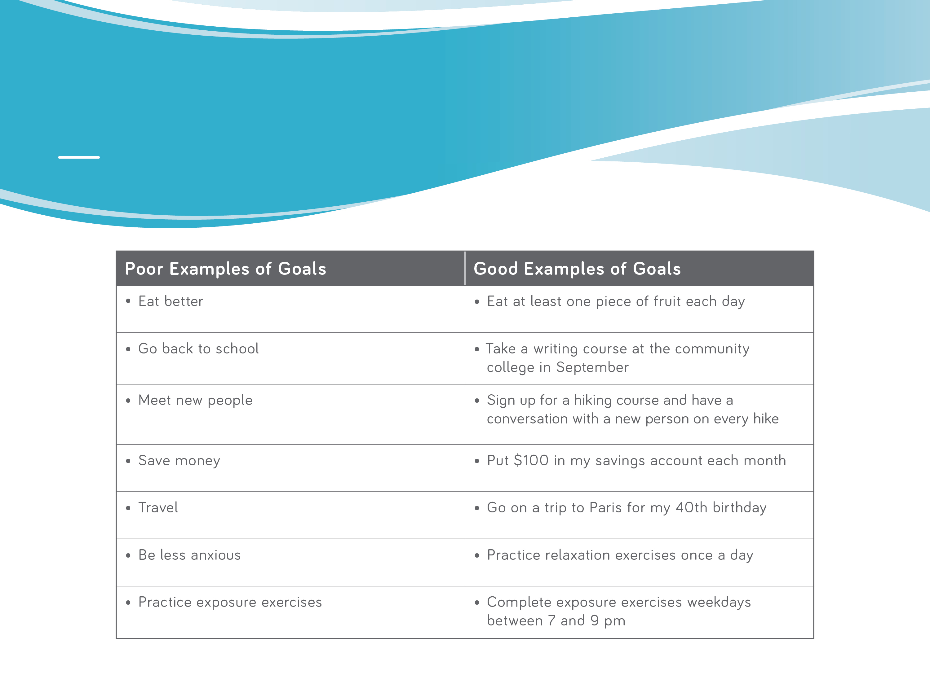
EXAMPLES
Notes:
Write down a goal for this week

Slide 82
^{PRACTICE}
HOMEWORK
• Go back to your thought record and identify which thinking trap ^{(or traps) you notice.}
Make one specific goal
- write it down
Check against SMART goals
Thought records
Mindfulness – 5 min twice/day
Specific
Measurable
Attainable
Relevant
Timely
Notes:
Tell the group that homework is a main component of CBT, and a large part of the work occurs between sessions. The more effort and time you put into doing the homework, the more you’ll get out of these classes.
• Set homework for upcoming week:
• Mindfulness meditation 5 minutes x twice/day
• Write down one specific goal for this week, and check to make sure it fits the SMART criteria.
• Continue trying to do thought records – as many as you can.
• Ask the Group: “Any questions about the homework?”

Slide 83

COGNITIVE BEHAVIOUR THERAPY WITH MINDFULNESS CLASSES
Session #3
Jitender Sareen MD, Tanya Sala MD, Jacquelyne Wong MA,
Debbie Whitney PhD, Jolene Kinley PhD
Notes:
Welcome to everyone!
Introduce facilitators.

Slide 84

OUTLINE FOR TODAY
Mindfulness
Review Behaviour Therapy
Review Homework
Healthy Living
Sleep
Homework
Notes:
Discuss the structure of the class:
Each week there will be an outline, mindfulness exercise, new material, homework.
Ask the group: “Are there any questions?”

Slide 85
HEALTHY
LIVING
Basic principles
Exercise
Nutrition
Reduce caffeine
Reduce alcohol/drugs
Sleep
Regular physical checkups
Choose one area of healthy living to work on at a time
Notes:
The mind & body are fundamentally integrated; what affects one affects the other.
Both anxiety and depression symptoms can occur in the context of physical illnesses, and the symptoms of some illnesses can feel just like anxiety and depression, e.g. thyroid disease. It’s important to have a regular physical health review with your primary care provider.
The basic building blocks of physical and mental wellness are good self-care strategies: sleep, exercise, nutrition, reducing substance use (caffeine, alcohol, illicit drugs, nicotine).

Slide 86
HOMEWORK
Mindfulness – 5 min twice/day
2 goals for this week
Include at least one Healthy Living goal
Exercise
Nutrition
Reduce caffeine
Reduce alcohol/drugs
Sleep
Notes:
Tell the group that homework is a main component of CBT, and a large part of the work occurs between sessions. The more effort and time you put into doing the homework, the more you’ll get out of these classes.
• Set homework for upcoming week:
• Mindfulness meditation 5 minutes x twice/day
• Write down two goals for this week – include at least one healthy living goal
• Ask the Group: “Any questions about the homework?”

Slide 87

COGNITIVE BEHAVIOUR THERAPY WITH MINDFULNESS CLASSES
Session #4
Jitender Sareen MD, Tanya Sala MD, Jacquelyne Wong MA,
Debbie Whitney PhD, Jolene Kinley PhD
Notes:
Welcome to everyone! Introduce facilitators.

Slide 88

OUTLINE FOR TODAY
Mindfulness
Review Homework
Anger, Assertiveness, Self-Compassion
Problem-Solving
Homework
Notes:
Discuss the structure of the class: Each week there will be an outline, mindfulness exercise, new material, homework. Ask the group: “Are there any questions?”

Slide 89
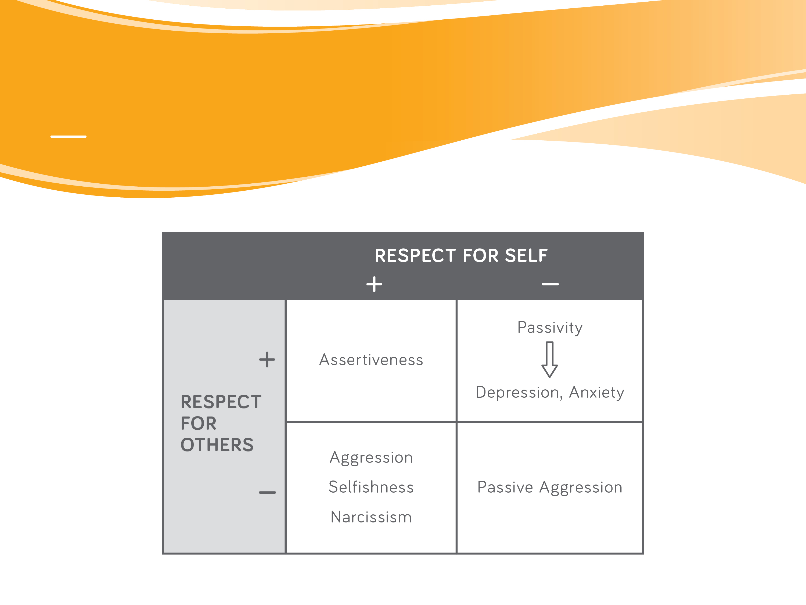
ANGER
Notes:
The bottom right square represents a situation where a person does not pay attention to their own needs or the needs of others. This is called Passive-Aggression, when a person doesn’t express his/her own needs and then gets angry with or resents others for not meeting their needs.
Many of us will recognize that we fall into each of these four squares in different situations, at different times in our lives, and with different people. However, if you believe that not enough of your responses fall in the assertiveness square (e.g. too many aggressive, passive or passive-aggressive responses), consider making it a goal to build assertiveness skills.

Slide 90
ASSERTIVENESS -
BASIC SKILLS
Notes:
• Assertiveness is a skill – anyone can learn to be more assertive!
• We’ll review some basic assertiveness skills as part of this class.
• Refer to the handout on assertive communication in your package for more information.

Slide 91
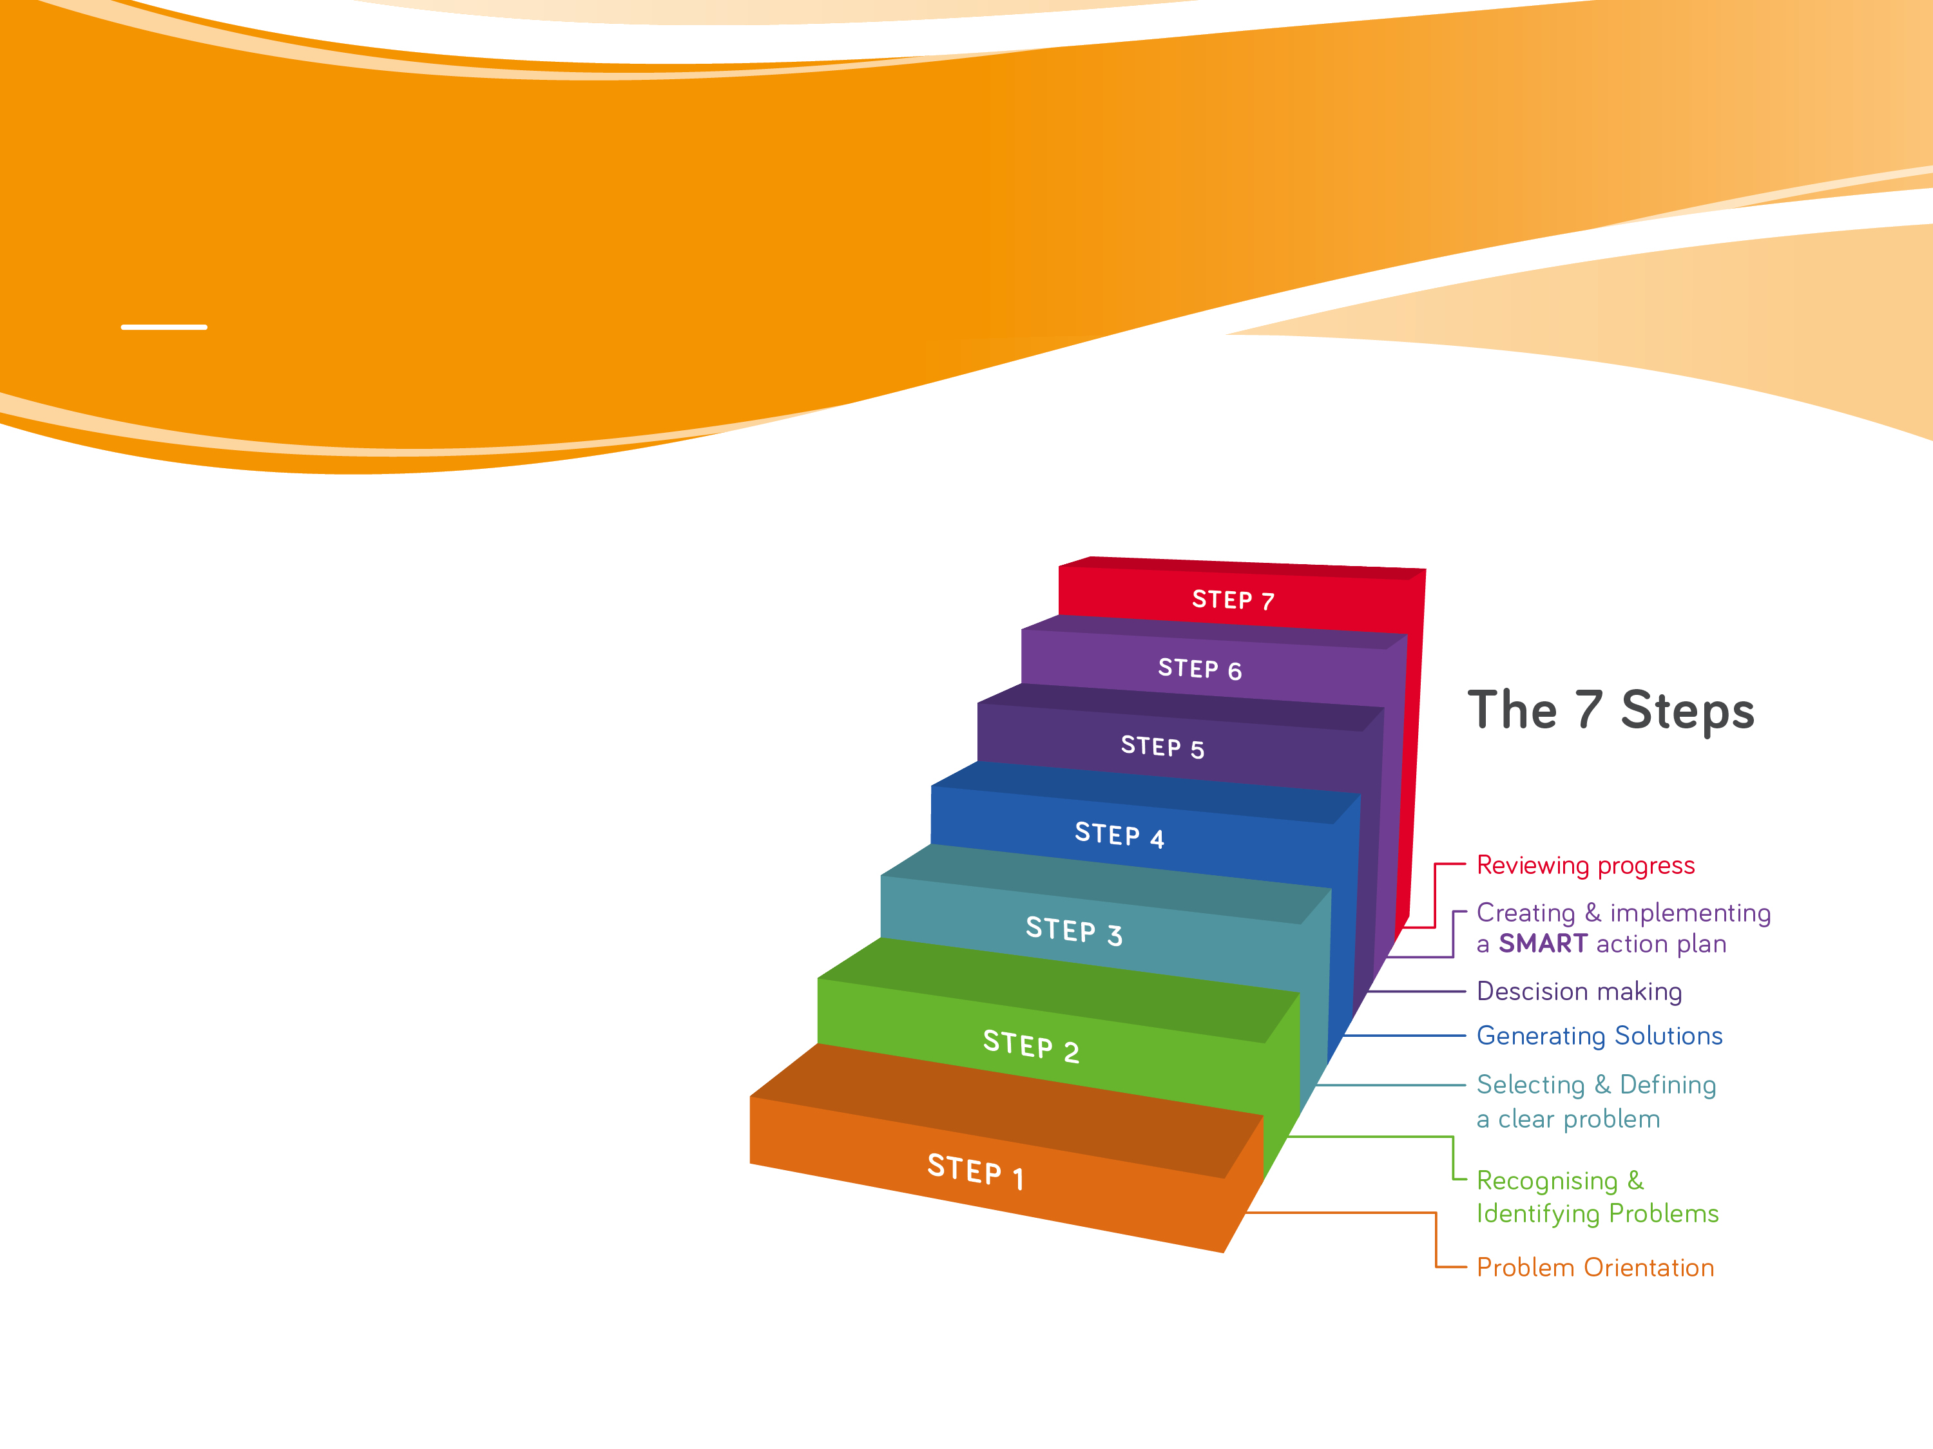
PROBLEM-SOLVING
http://www.problemsolvingtherapy.ac.nz/
Videos
Step by step approach to problems
Notes:
When to use problem solving:
• When thoughts/feelings fit well with the facts after completing a thought record; e.g. you’ve identified a realistic problem that needs to be dealt with.
• When you’ve identified goals, e.g. things you want to work on as part of your recovery.
• When there are things you can do to change the situation.
Problem-solving is a strategy to transform the goals you’ve set into action. Problem-solving therapy is an approach to dealing with problems, so that you don’t feel overwhelmed when faced with a problem. It gives you a set of tools to help you organize your thinking and your approach to dealing with the problem.
Instruct patients to review website.

Slide 92
HOMEWORK
Mindfulness 5 min twice/day
Two thought records in the week (Testing Your Thoughts worksheet)
Visit problem-solving website for 15 min
Fill out problem-solving sheet
Work on 3 SMART goals
Notes:
Tell the group that homework is a main component of CBT, and a large part of the work occurs between sessions. The more effort and time you put into doing the homework, the more you’ll get out of these classes.
• Set homework for upcoming week:
• Mindfulness meditation 5 minutes x twice/day
• Two thought records
• Fill out problem-solving worksheets
• Work on 3 SMART goals
• Ask the Group: “Any questions about the homework?”
• Instruct patients to fill-out quality improvement questionnaires.

